Slide 1


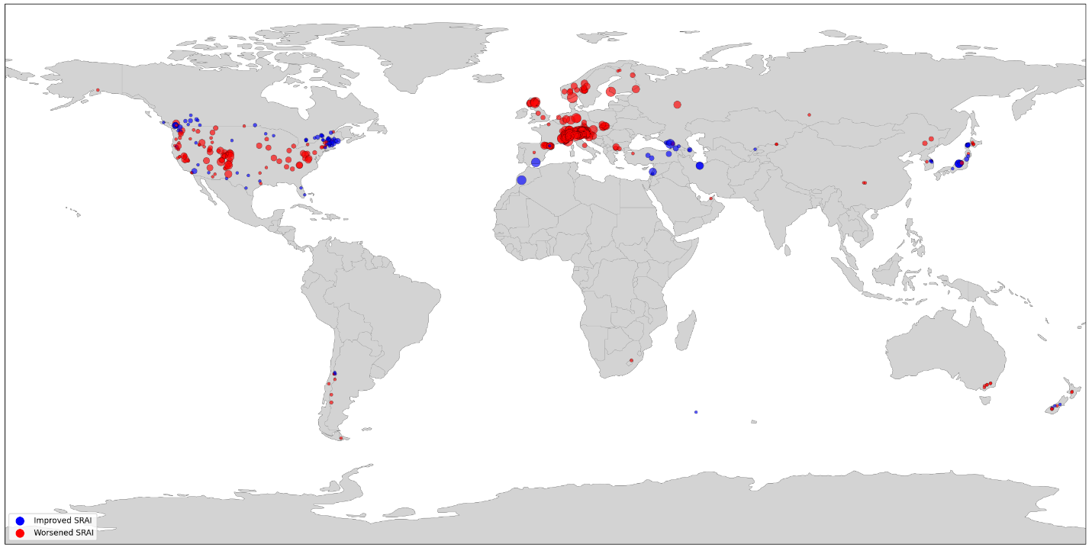
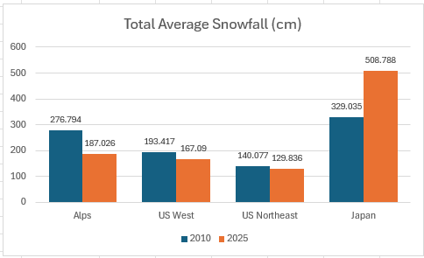
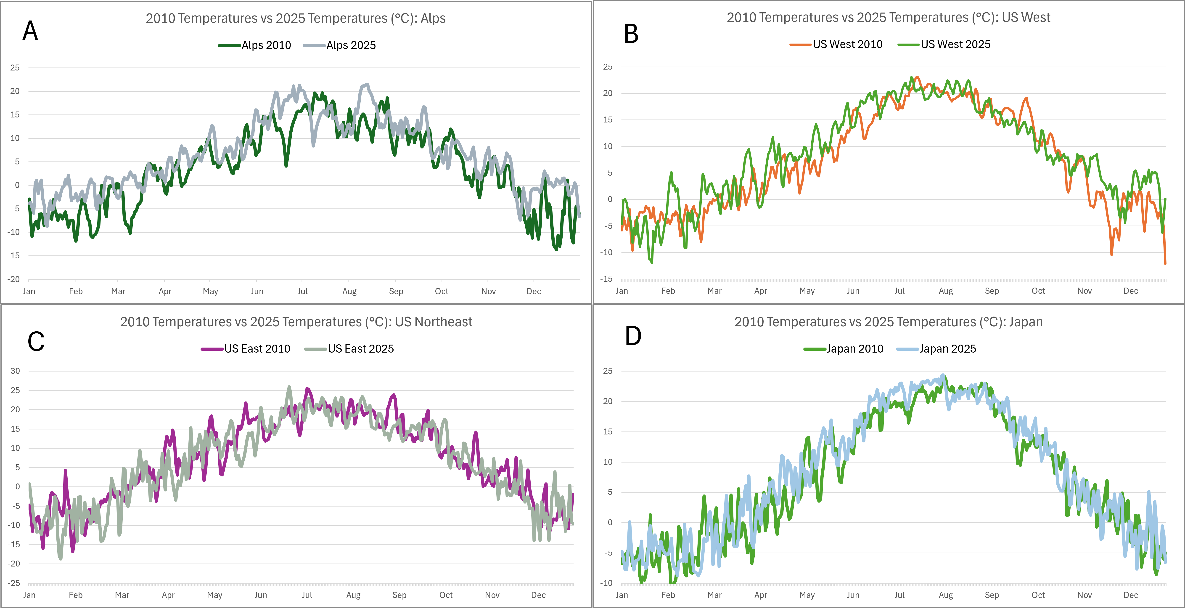
Changes in Ski Resort Climatology
in the Last 15 Years
Team ID Number
2026 NCTSA Western Regionals Conference
Introduction
Results
Conclusion
Ski resorts are often a top choice for many tourists to do physical exercise in a beautiful snow-covered environment while having fun with friends and family. However, a 2018 report from NOAA’s climate branch predicted by the end of the century, global warming would cause temperatures to rise “an average of 6°F to 9°F” and would raise the rain-to-snow elevation “anywhere from 1,500 feet to 3,000 feet,” limiting the snow available for skiing (Scott). And with less snow, ski resorts will attract less visitors, which over time will lead to reduced profits. In general, winter sports are severely threatened by global warming.
Many recognize that climate change does not affect only winter sports. Indeed, the consequences of climate change affect everyone. As the planet warms up, the temperature of the planet affects nature cycles and leads to snow and ice melting, raising the sea level. A rising sea level can flood coasts, erode land, and damage coastal ecosystems. Additionally, damaged environments can lead to tourist spots becoming dangerous, reducing tourism income for countries that may rely on it. It can create challenges to grow and find food or shelter, and clean water can be difficult to get. Global warming also causes conflict in policy in governments, whose decisions to either confront or ignore it can further exacerbate its impacts.
Ski Resort Attractiveness Index (SRAI)
  Results were largely expected
  Climate change decreased majority of resorts’ SRAIs
  Conditions worsened, resort became less attractive
  Temperatures generally increased in clustered areas
  Alps and US experienced decreased snowfall from 2010 to 2025
  More snow melts into water before landing on ground due to higher temperatures, also contributing to rising sea levels
  Some unexpected results appeared during analysis as well
Some scattered areas had resorts that had increased SRAI (US Northeast, Japan, Caucasus region)
Believe this may be due to other factors in our formula
These regions are near larger bodies of water, so wind and humidity may play bigger parts
The US and Japan has less notable temperature differences than the Alps
Believe this is due to proximity to major ocean, helping to regulate temperature changes
Japan’s snowfall increased significantly (about 54%)
Discovered cause to be strong, consistent La Niña conditions since 2020, leading to “an impressive 311cm of snow” in December 2024 and a snowfall total of “12 [to] 13 metres” by end of ski season (“From”)
Predict trends to continue or get worse
Alps temperatures will likely continue to rise, eventually leading to scarce natural snow that will impact tourists
Snowfall in most countries will continue to decrease as rate of melting increases
Japan’s La Niña conditions will eventually end, but they may not experience decreased snowfall until later years
SRAI determined with weighted formula consisting of all climate variables collected
From 2010 to 2025, majority of resorts in Alps and US West regions had decreased SRAI
Scattered areas with improved SRAI, notably US Northeast, Japan, and Caucasus region
Purpose
This project aims to illustrate the impact of global warming through a detailed analysis of the climate data of 554 resorts in the years 2010 and 2025. By studying how different factors, notably temperature and snowfall, have changed over time, we can determine how climate change has affected ski resorts and predict how it may affect them in the future.
Total Snowfall
Temperature Changes
Alps and US had decreased snowfall from 2010 to 2025
                Japan’s snowfall increased – due to strong La Niña conditions
The Alps have most notable temperature increase from 2010 to 2025
US and Japan experienced slight temperature changes
Methods
We researched through numerous lists of popular ski resorts and their locations from various websites, crosschecking to ensure accuracy.
Then, we determined the latitude and longitude of each location with a Python script.
With the latitude and longitude, we determined climate data from 2010 and 2025 using Open-Meteo, tracking the following variables:
          a) Mean temperature (apparent and wet-bulb)
          b) Mean, maximum, and minimum cloud cover
          c) Mean relative humidity
          d) Rain, snowfall, and snowfall water equivalent sums
          e) Daylight duration and shortwave radiation sum
          f) Mean and maximum wind speed and wind gusts
          g) Mean surface pressure
          h) Maximum vapour pressure deficit
Next Steps (TPACK)
References
    Improve the scope of the data by increasing the number of resorts data is collected from or by increasing the number of years data is collected from, possibly highlighting smoother climate trends year-to-year and clearly showing any outliers (ex. Japan’s recent historic snowfall)
    Perform more thorough analysis of the data, focusing on other climate effects like percentage of snowfall that turned into rain (providing greater insights on impact of rising temperatures on snowfall totals) and effects of climate change on surface pressure and its impact on precipitation
    Short-term solutions include temporary use of artificial snow and collective initiative to reduce climate change through green energy, efficiency, and increased sustainability
    “From Hokkaido to Honshu: Japan’s 2024/25 Season in Review.” MountainWatch Travel, 30 Apr. 2025, mountainwatch.travel/blog/japans-2024-25-season-in-review/.
    Scott, Michon. “Climate & Skiing.” NOAA Climate.Gov, 19 Nov. 2018, www.climate.gov/news-features/climate-and/climate-skiing.
Notes:
1

